Slide 1
Student Mark AnalysisSystem
Naveen kumar Ravikumar

Slide 2
Project Abstract
The aim of this project is to analyze the Comprehensive Examination result of the past two semesters(i.e)Nov18 and Nov19||(first semester result for the same subject)||
first semester result of two different batch student 2018 and 2019 were analyzed.
It is checked with the three Continuous Assessment test and the attendance percentage of the students.

Slide 3
Stakeholders
Education institutes
Teachers
Administrators
students

Slide 4
Software Requirements
Application name :Python
Version :3.6

Slide 5
Hardware configuration
Device name : HP
Processor :AMD PRO A4-3350
Graphics :2.00 GHZ
RAM :4.00GB
OS :windows 10 pro
System type :32-bit OS

Slide 6
Advantages
This system reduces manual work to great extent.
Easy computation
Clear and through analysis of results leads to a comprehensive report generation which is useful for all the stakeholders including teachers , administrators and students.

Slide 7
Data preprocessing
The data is gathered from different source it is collected in raw format . Which is not feasible for the analysis.
Pre-processing refers to the transformation applied to the data before feeding it to the algorithm
Data pre-processing needs for achieving better result from the applied model in machine of the data has to be in proper manner

Slide 8
Structure data
Exploration Data Analysis
Raw data
Data processing
Insight reports visual graphs

Slide 9
Function of our project
First of all we used the data pre-processing method for the proper result.
Next use seaborn method for data visualization in informative statistical graphics.
Next we use the histogram to represent the performance level like good , average , worst.
And finally we use the boxplots for data comparison the distribution ,it represents the minimum , maximum, median in the given dataset

Slide 10
Source code
import pandas as pd
import os
import csv
os.chdir("E:")
df=pd.read_csv("E:\mark1.csv")
list1=pd.DataFrame(df,columns=["subcode"])
print(list1)
list2=df.subcode.unique()
print(list2)
list3=df.regno.unique()
print(list3)
hdr = ['regno','name','sec','dept']
for l in list2:
print (l)

Slide 11
hdr.append(str(l)+'ca1')
hdr.append(str(l)+'ca2')
hdr.append(str(l)+'ca3')
hdr.append(str(l)+'int')
hdr.append(str(l)+'ext')
hdr.append(str(l)+'tot')
hdr.append(str(l)+'result')
hdr.append(str(l)+'att')
print(hdr)
with open('E:\mark2.csv','w',newline='') as file:
writer = csv.writer(file)
writer.writerow(hdr)
i=0
for rn in list3:
n=df.name[df['regno'] == rn]
s=df.sec[df['regno'] == rn]
d=df.dept[df['regno'] == rn]
a=[rn,n.unique()[i],s.unique()[i],d.unique()[i]

Slide 12
for sc in list2:
c1=df.ca1[(df['regno']==rn) & (df['subcode']==sc)]
a.append(str(c1.unique())[1:-1])
c2=df.ca2[(df['regno']==rn) & (df['subcode']==sc)]
a.append(str(c2.unique())[1:-1])
c3=df.ca3[(df['regno']==rn) & (df['subcode']==sc)]
a.append(str(c3.unique())[1:-1])
i1=df.int[(df['regno']==rn) & (df['subcode']==sc)]
a.append(str(i1.unique())[1:-1])
e1=df.ext[(df['regno']==rn) & (df['subcode']==sc)]
a.append(str(e1.unique())[1:-1])
t1=df.total[(df['regno']==rn) & (df['subcode']==sc)]
a.append(str(t1.unique())[1:-1])
r1=df.result[(df['regno']==rn) & (df['subcode']==sc)]
a.append(str(r1.unique())[1:-1])

Slide 13
a1=df.att[(df['regno']==rn) & (df['subcode']==sc)]
a.append(str(a1.unique())[1:-1])
writer.writerow(a)
mean:
import pandas as pd
import os
import csv
os.chdir("E:")
df=pd.read_csv("E:\mark1.csv")
df1=pd.read_csv("E:\mark2.csv")
list1=df.subcode.unique()
print(list1)
hdr1 = ['subcode','ca1','ca2','ca3','int','ext']
with open('E:\mean.csv','w',newline='') as file:
writer = csv.writer(file)
writer.writerow(hdr1)

Slide 14
for l in list1:
ca1 = str(l)+'ca1'
ca1v = (df1[ca1].mean())
ca2 = str(l)+'ca2'
ca2v = (df1[ca2].mean())
ca3 = str(l)+'ca3'
ca3v = (df1[ca3].mean())
int1 = str(l)+'int'
intv = (df1[int1].mean())
ext = str(l)+'ext'
extv = (df1[ext].mean())
arg = [l,ca1v,ca2v,ca3v,intv,extv]
print(arg)
writer.writerow(arg)

Slide 15
BARPLOT
import numpy as np
import matplotlib.pyplot as plt
data=[[241.0,28.120332,14.975467,0.0,17.0,30.0,38.0,65.0],
[230.0,27.382609,14.981551,0.0,14.0,30.0,38.0,63.0]]
x=np.arange(8)
plt.bar(x+0.0,data[0],color='b',width=0.25)
plt.bar(x+0.25,data[1],color='g',width=0.25)
plt.title("18UCSM101ca1")
print(plt.show())

Slide 16
data1=[[239.0,35.623431,14.879644,0.0,25.0,33.0,46.0,70.0],
[230.0,29.773913,14.127344,0.0,20.0,30.0,38.0,75.0]]
x=np.arange(8)
plt.bar(x+0.0,data1[0],color='b',width=0.25)
plt.bar(x+0.25,data1[1],color='g',width=0.25)
plt.title("18UCSM101ca2")
print(plt.show())
data2=[[241.0,1.471784,0.649192,0.0,1.0,1.5,1.8,3.3],
[230.0,2.086522,0.813124,0.0,1.5,2.0,2.5,4.7]]
x=np.arange(8)
plt.bar(x+0.0,data2[0],color='b',width=0.25)
plt.bar(x+0.25,data2[1],color='g',width=0.25)
plt.title("18UCSM101ca3")
print(plt.show())

Slide 17
data3=[[241.0,14.713693,3.216653,0.0,13.00,15.0,17.0,21.0],
[230.0,15.482609,2.861757,5.0,13.25,15.5,18.0,23.0]]
x=np.arange(8)
plt.bar(x+0.0,data3[0],color='b',width=0.25)
plt.bar(x+0.25,data3[1],color='g',width=0.25)
plt.title("18UCSM101int")
print(plt.show())
data4=[[237.0,27.654008,12.162325,0.0,17.0,30.0,35.0,59.0],
[230.0,35.291304,12.033338,0.0,30.0,34.0,42.0,65.0]]
x=np.arange(8)
plt.bar(x+0.0,data4[0],color='b',width=0.25)
plt.bar(x+0.25,data4[1],color='g',width=0.25)
plt.title("18UCSM101ext")
print(plt.show())

Slide 18
data5=[[239.0,92.133347,10.436266,0.0,89.65,95.7,98.2,100.0],
[230.0,94.630435,5.559361,68.0,93.00,96.0,99.0,100.0]]
x=np.arange(8)
plt.bar(x+0.0,data5[0],color='b',width=0.25)
plt.bar(x+0.25,data5[1],color='g',width=0.25)
plt.title("18UCSM101att")
print(plt.show())
data6=[[237.0,42.430380,14.265952,0.0,31.0,45.0,51.0,78.0],
[230.0,50.773913,13.903322,5.0,44.0,50.0,59.0,85.0]]
x=np.arange(8)
plt.bar(x+0.0,data6[0],color='b',width=0.25)
plt.bar(x+0.25,data6[1],color='g',width=0.25)
plt.title("18UCSM101tot")
print(plt.show())

Slide 19
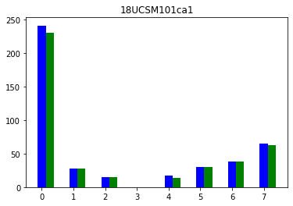
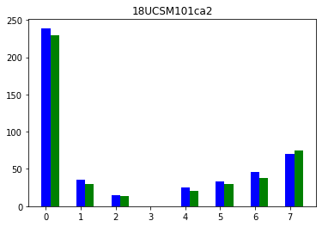
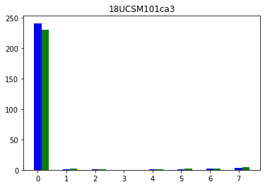
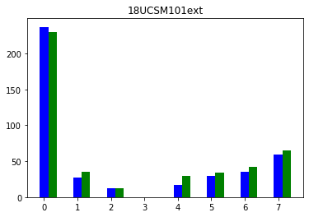
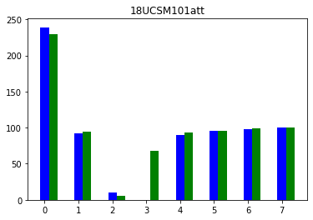
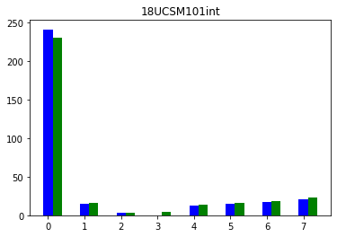
NOVEMBER-2018
NOVEMBER-2019

Slide 20
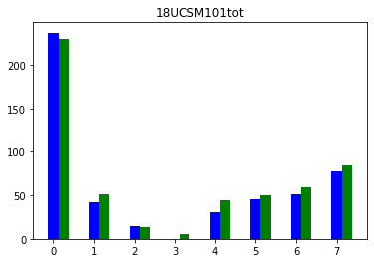

Slide 21
HISTOGRAM
import pandas as pd
import os
os.chdir("E:")
rslt=pd.read_csv("E:\mark0.csv")
import matplotlib.pyplot as plt
rslt["18UCSM101ca1"].fillna(rslt["18UCSM101ca1"].mean(),inplace=True)
plt.hist(rslt["18UCSM101ca1"])
plt.title("Range of Marks Secured by Students(18UCSM101ca1)")
plt.xlabel("Marks")
plt.ylabel("No. of Students")
print(plt.show())
rslt["18UCSM101ca2"].fillna(rslt["18UCSM101ca2"].mean(),inplace=True)
plt.hist(rslt["18UCSM101ca2"])
plt.title("Range of Marks Secured by Students(18UCSM101ca2)")
plt.xlabel("Marks")
plt.ylabel("No. of Students")
print(plt.show())

Slide 22
rslt["18UCSM101ca3"].fillna(rslt["18UCSM101ca3"].mean(),inplace=True)
plt.hist(rslt["18UCSM101ca3"])
plt.title("Range of Marks Secured by Students(18UCSM101ca3)")
plt.xlabel("Marks")
plt.ylabel("No. of Students")
print(plt.show())
rslt["18UCSM101int"].fillna(rslt["18UCSM101int"].mean(),inplace=True)
plt.hist(rslt["18UCSM101int"])
plt.title("Range of Marks Secured by Students(18UCSM101int)")
plt.xlabel("Marks")
plt.ylabel("No. of Students")
print(plt.show())

Slide 23
rslt["18UCSM101ext"].fillna(rslt["18UCSM101ext"].mean(),inplace=True)
plt.hist(rslt["18UCSM101ext"])
plt.title("Range of Marks Secured by Students(18UCSM101ext)")
plt.xlabel("Marks")
plt.ylabel("No. of Students")
print(plt.show())
rslt["18UCSM101att"].fillna(rslt["18UCSM101att"].mean(),inplace=True)
plt.hist(rslt["18UCSM101att"])
plt.title("Range of Marks Secured by Students(18UCSM101att)")
plt.xlabel("Marks")
plt.ylabel("No. of Students")
print(plt.show())

Slide 24
rslt["18UCSM101tot"].fillna(rslt["18UCSM101tot"].mean(),inplace=True)
plt.hist(rslt["18UCSM101tot"])
plt.title("Range of Marks Secured by Students(18UCSM101tot)")
plt.xlabel("Marks")
plt.ylabel("No. of Students")
print(plt.show())

Slide 25
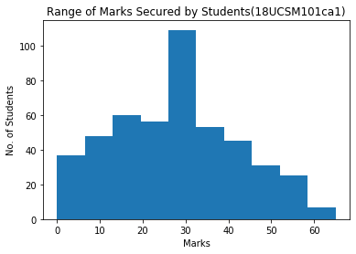
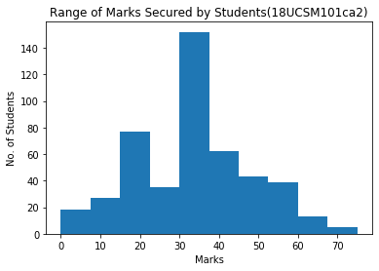
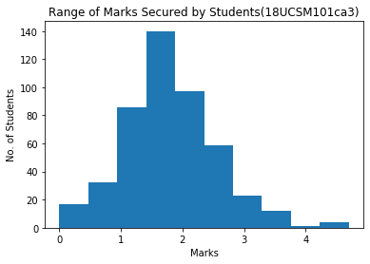
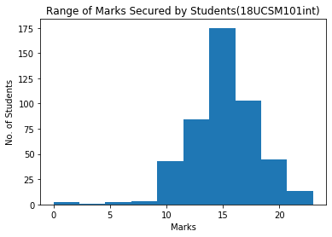
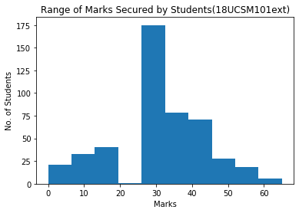
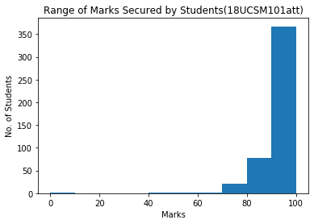
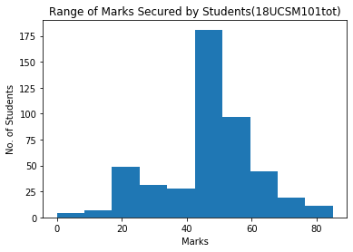

Slide 27
BOXPLOT
import pandas as pd
import os
os.chdir("E:")
rslt=pd.read_csv("E:\mark0.csv")
import seaborn as sns
sns.boxplot(x=rslt["yop"],y=rslt["18UCSM101ca1"])
sns.boxplot(x=rslt["yop"],y=rslt["18UCSM101ca2"])
sns.boxplot(x=rslt["yop"],y=rslt["18UCSM101ca3"])
sns.boxplot(x=rslt["yop"],y=rslt["18UCSM101int"])
sns.boxplot(x=rslt["yop"],y=rslt["18UCSM101ext"])
sns.boxplot(x=rslt["yop"],y=rslt["18UCSM101att"])
sns.boxplot(x=rslt["yop"],y=rslt["18UCSM101tot"])

Slide 28
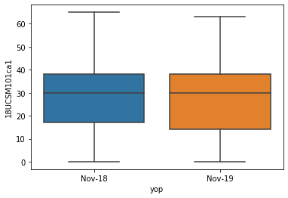
CONTINUOUS ASSESSMENT 1
count mean std min 25% 50% 75% max
yop
Nov-18 241.0 33.049793 14.179122 0.0 22.0 34.0 42.00 64.0
Nov-19 230.0 36.830435 16.027050 0.0 30.0 35.0 46.75 75.0

Slide 29
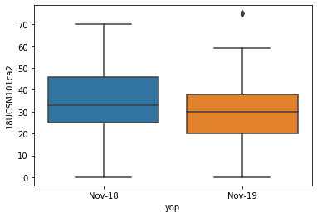
CONTINUOUS ASSESSMENT 2
count mean std min 25% 50% 75% max
yop
Nov-18 239.0 39.594142 14.236247 0.0 30.0 40.0 51.0 70.0
Nov-19 230.0 39.091304 12.742509 0.0 30.0 40.0 47.0 67.0

Slide 30
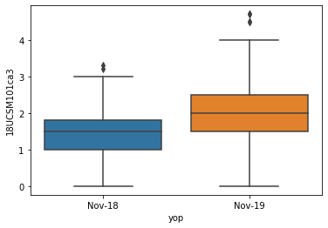
CONTINUOUS ASSESSMENT 3
count mean std min 25% 50% 75% max
yop
Nov-18 241.0 1.598340 0.712739 0.0 1.2 1.7 2.000 3.0
Nov-19 230.0 1.921304 0.601692 0.0 1.5 2.0 2.425 3.2

Slide 31
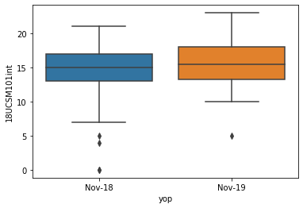
INTERNAL MARKS
count mean std min 25% 50% 75% max
yop
Nov-18 239.0 15.556485 2.749322 0.0 14.0 16.0 17.0 21.0
Nov-19 230.0 16.669565 2.551553 10.0 15.0 17.0 19.0 22.0

Slide 32
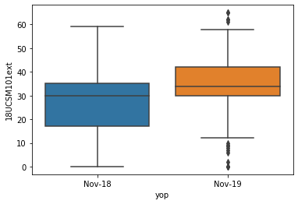
EXTERNAL MARKS
count mean std min 25% 50% 75% max
yop
Nov-18 237.0 36.632911 11.977214 0.0 31.0 37.0 43.0 69.0
Nov-19 230.0 38.934783 10.890888 0.0 33.0 39.0 45.0 64.0

Slide 33
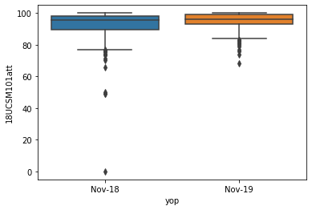
ATTENDANCE
count mean std min 25% 50% 75% max
yop
Nov-18 241.0 92.079419 11.472932 0.0 89.2 96.0 100.0 100.0
Nov-19 230.0 95.669565 4.749115 76.0 94.0 97.0 100.0 100.0

Slide 34
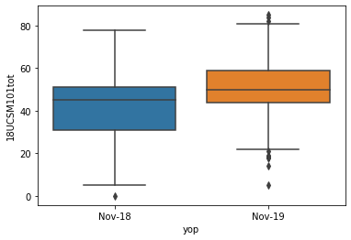
TOTAL(INTERNAL+EXTRENAL)
count mean std min 25% 50% 75% max
yop
Nov-18 237.0 52.156118 13.676843 0.0 46.0 52.0 60.0 88.0
Nov-19 230.0 55.604348 11.829760 11.0 48.0 55.0 62.0 84.0

Slide 35
18UCSM101

Slide 36
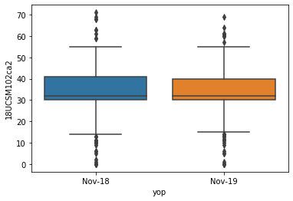
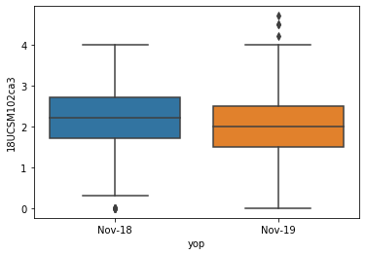
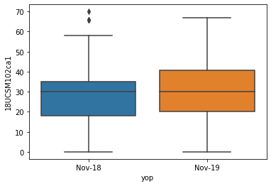
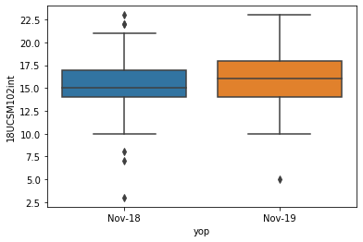
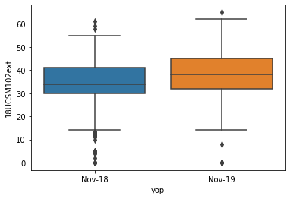
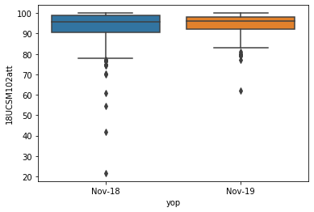
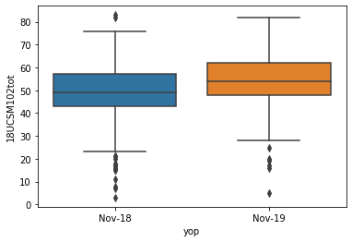
18UCSM102

Slide 37
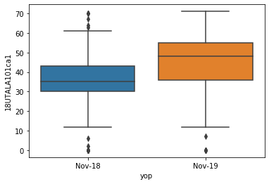
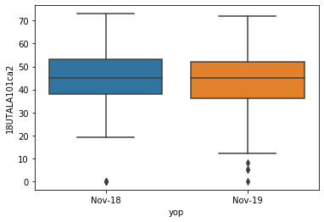
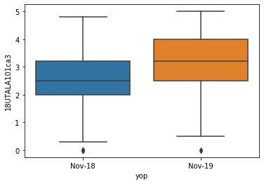
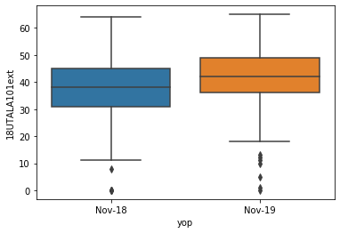
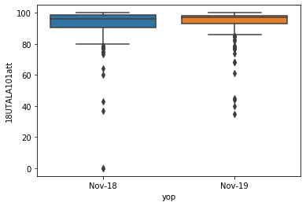
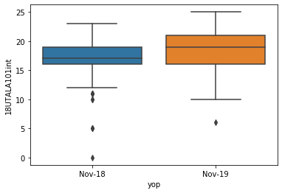
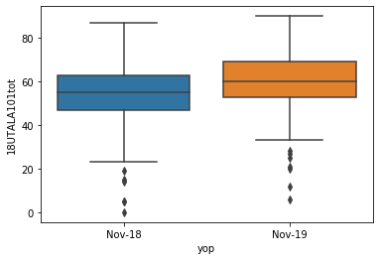
18UTALA101

Slide 38
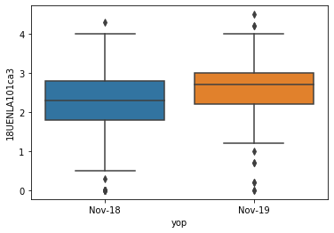
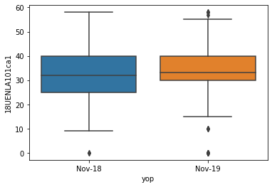
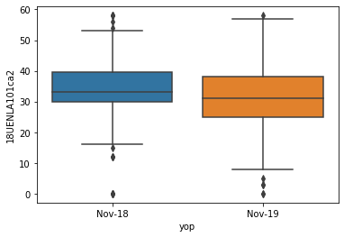
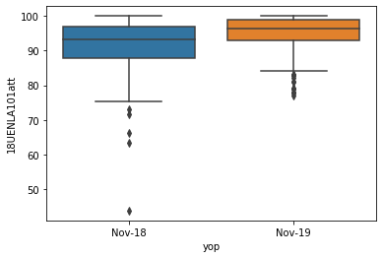
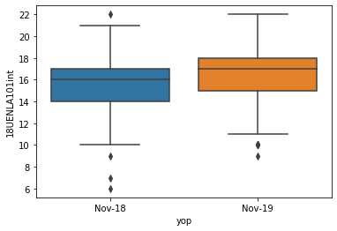
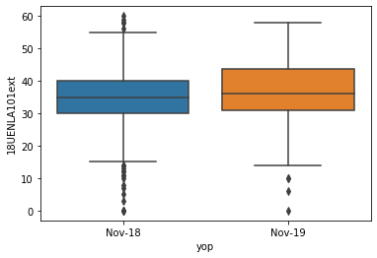
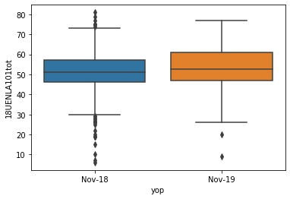
18UENALA101

Slide 39
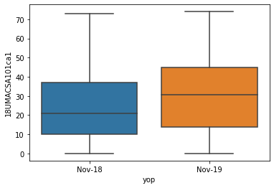
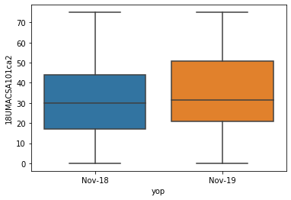
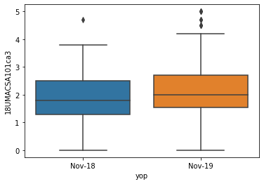
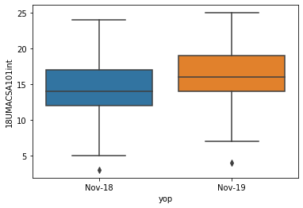
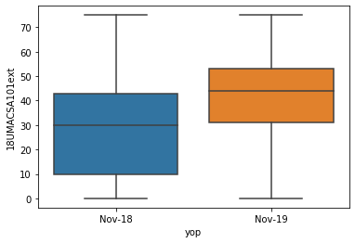
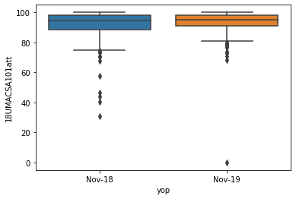
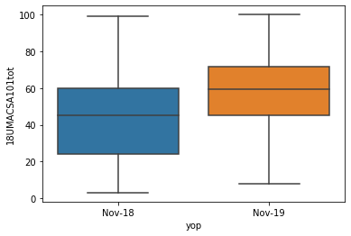
18UMACSA101

Slide 40
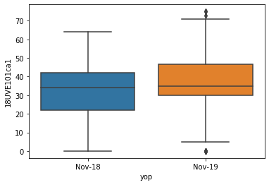






18UVE101

Slide 41
CONCLUSION
The above said improvement is achieved by securing high
Levels in the continuous Assessment tests and improvement in attendance percentage.

Slide 42
THE END
THANKING YOU

